Slide 1



Build high-performance APIs with gRPC and .NET
Mehmet Kut
Technical Trainer @Microsoft Turkey
@mehmetkut

Slide 2
Agenda
What is gRPC
Demo
What’s new in .NET 5
New features
Improved performance
gRPC and WCF
Resources
Documentations
Samples
Tools
@mehmetkut

Slide 3




gRPC is…
Popular open source RPC framework
Largest RPC mindshare
Cloud Native Computing Foundation project
gRPC stands for gRPC Remote Procedure Calls
Built with modern technologies
HTTP/2
Protobuf
Designed for modern apps
High performance
Platform independent
+
=
@mehmetkut

Slide 4
Protobuf (aka Protocol Buffers)
syntax = "proto3";
message SubscribeRequest {
string topic = 1;
}
message Event {
int32 id = 1;
string details = 2;
}
IDL (interface definition language)
Describe once and generate interfaces for any language
Service model
Service method and structure of the request and the response
Wire format
Binary format for network transmission
5052 4920 2a20 4854 5450 2f32
0d0a 534d 0d0a 0d0a 0000 0004
0000 0000 0401 0000 0000 0000
service Topics {
rpc Subscribe(SubscribeRequest)
returns (stream Event);
}
@mehmetkut

Slide 5












Supported by Multiple Languages & Frameworks

Slide 6

Remote Procedure Calls vs HTTP APIs
Remote Procedure Calls
HTTP APIs
Contract first (proto file)
Content first (URL, HTTP method, JSON)
Contract is for humans
Content is for humans
Hides remoting complexity
Emphasises HTTP
Performance
Developer productivity
Widest audience
Ease of getting started
@mehmetkut

Slide 7
Demo
Create gRPC service using template
Create gRPC client
Call service
@mehmetkut

Slide 8
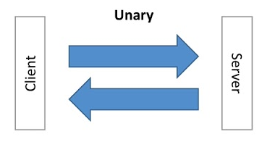
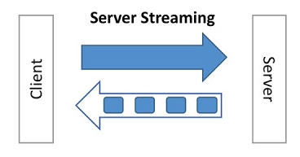
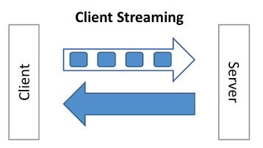
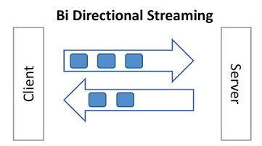
Streaming & bi-directional
gRPC uses HTTP/2 to enable streaming

Slide 9
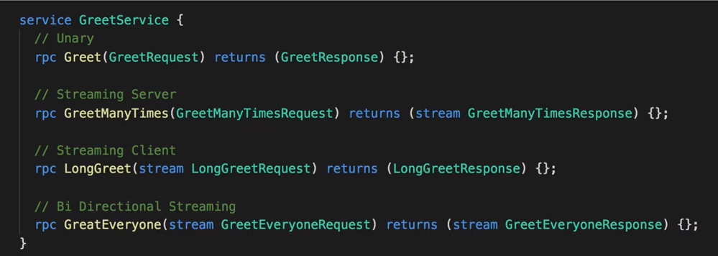
gRPC Service Methods
@mehmetkut

Slide 10




What’s new in .NET 5
gRPC-Web browser support
gRPC-Web Server middleware
gRPC-Web Blazor client
New gRPC hosts on Windows
HTTP.sys
IIS
Inter-process communication
.NET 5 aggressive trimming
@mehmetkut

Slide 11
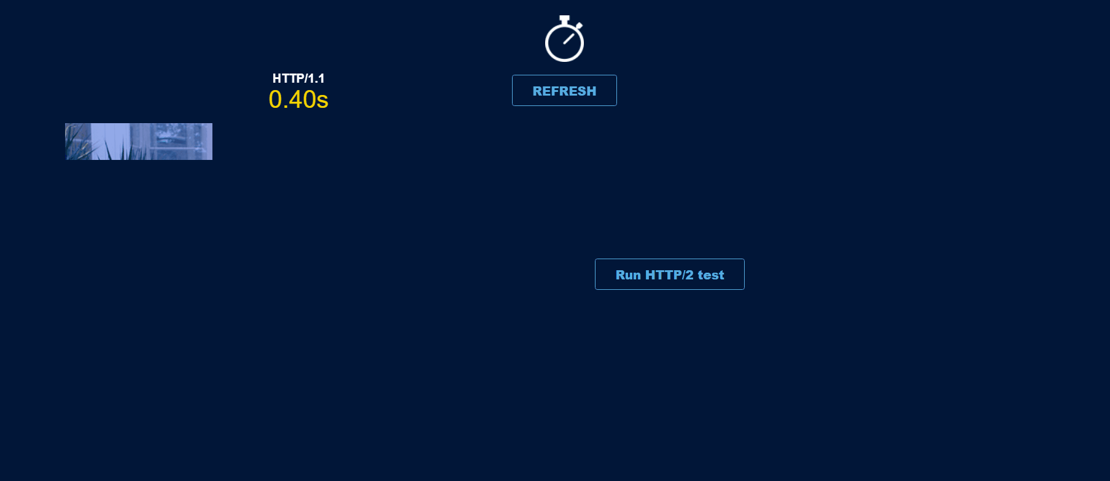
Performance – HTTP/2
HTTP/2 multiplexing
Multiple calls via a TCP connection
Avoid head-of-line blocking
@mehmetkut

Slide 12
Performance – Bandwidth
Low network usage
HTTP/2 binary framing and header compression
Protobuf message serialization
{
"query": "myQuery",
"page_number": 42,
"result_per_page": 100,
"tickers": [
{
"name": "rPs",
"value": 9.768923
},
{
"name": "WEo",
"value": 6.067048
}
]
}
5052 4920 2a20 4854 5450 2f32
0d0a 534d 0d0a 0d0a 0000 0004
0000 0000 0401 0000 0000 0000
syntax = "proto3";
package sample;
message Test {
string query = 1;
int32 page_number = 2;
int32 result_per_page = 3;
repeated Ticker tickers = 4;
}
message Ticker {
string name = 1;
float value = 2;
}
https://nilsmagnus.github.io/post/proto-json-sizes/
@mehmetkut

Slide 13
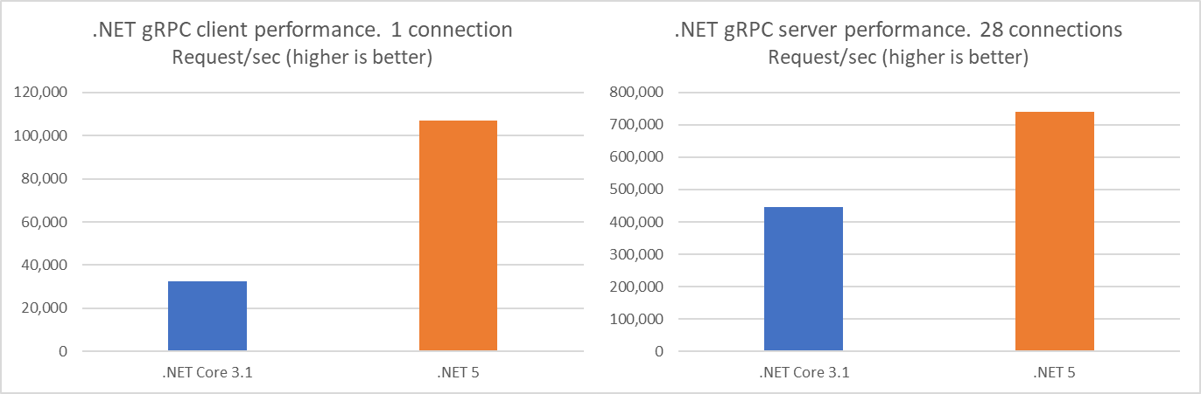
Performance - .NET Core 3.1 vs .NET 5
@mehmetkut

Slide 14
Performance – Implementations
@mehmetkut

Slide 15

gRPC vs WCF
Remote Procedure Calls
WCF
Proto file contract
Code generates WSDL contract
HTTP/2 streaming
Streaming is transport dependent
HTTP header metadata
Message envelope metadata
IPC over Unix domain sockets
IPC over named pipes
TLS, JWT tokens, certificate auth
WS-Security, WS-Federation, XML encryption
@mehmetkut

Slide 16
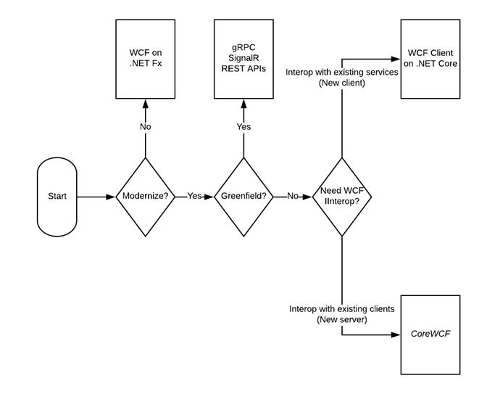
gRPC and WCF
Use gRPC in new and modernized apps
WCF is still available on .NET Framework
CoreWCF is a community implementation
@mehmetkut

Slide 17
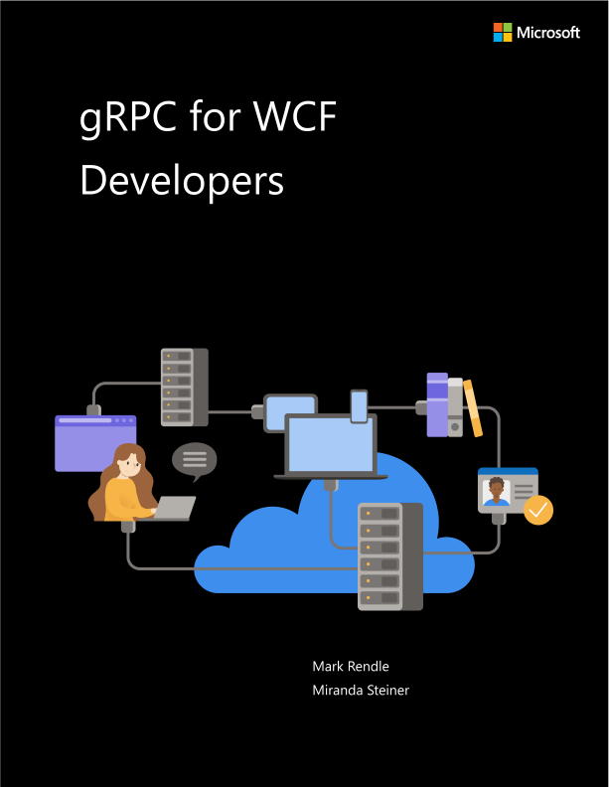
gRPC for WCF developers
E-book for WCF developers
Authored by Mark Rendle
Comparison of technologies
Migration example
https://aka.ms/grpcwcfebook
@mehmetkut

Slide 18
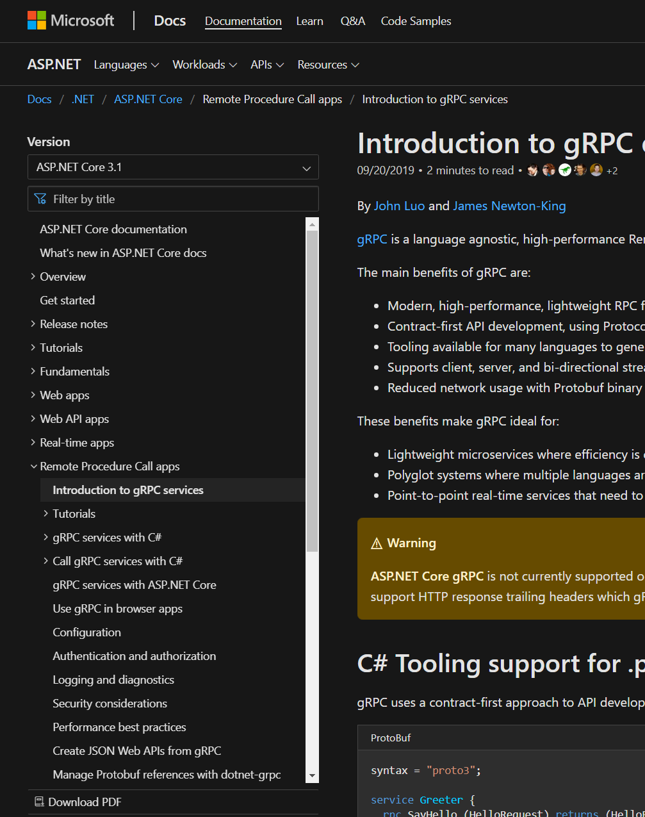
Resources – Docs
Intro tutorial
Creating gRPC services
Calling gRPC services
Create Protobuf messages
Versioning gRPC services
Use gRPC in browser apps
Create JSON Web APIs from gRPC
Performance best practices
And more
https://aka.ms/grpcdocs
@mehmetkut

Slide 19
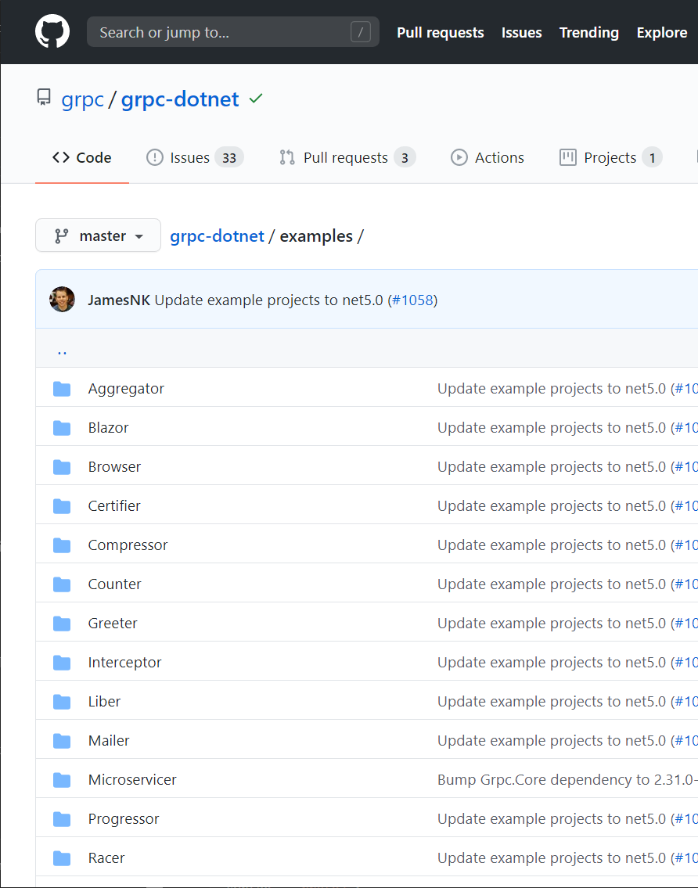
Resources – Examples
Hello world
Streaming
Certificate authentication
JWT authentication
OpenTelemetry
Unix domain sockets
Unit testing
Cancellation
And more
https://aka.ms/grpcexamples
@mehmetkut

Slide 20
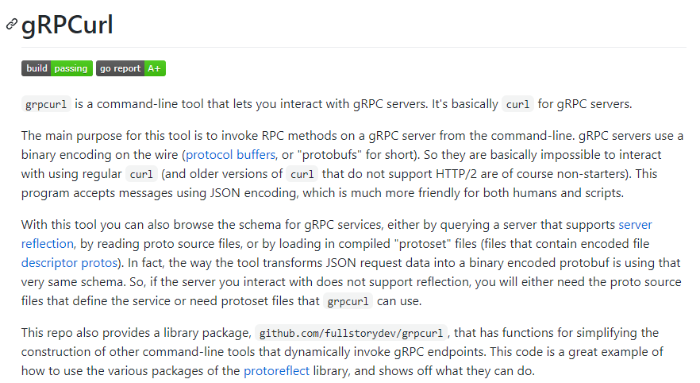
Resources – gRPCurl
https://github.com/fullstorydev/grpcurl
@mehmetkut

Slide 21
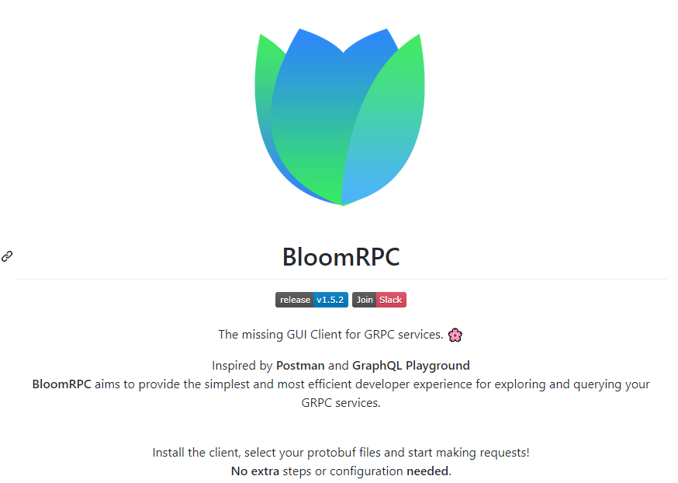
Resources – gRPCurl
https://github.com/uw-labs/bloomrpc
@mehmetkut

Slide 22
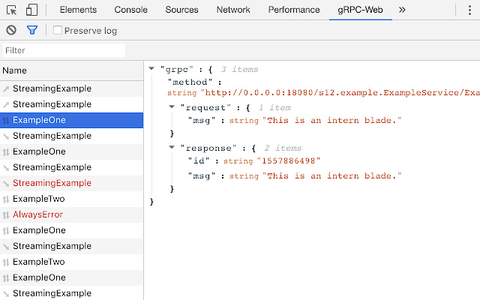
Resources – gRPC-Web Developer Tools
@mehmetkut

Slide 23

Thanks for joining !
@mehmetkut

